Slide 1






SUMMER TRAINING PROJECT
MULTI-FUNCTIONAL GUI
APPLICATION
BACHELOR OF TECHNOLOGY
DEPARTMENT OF COMPUTER SCIENCE AND ENGINEERING
• COLLEGE: - UNITED COLLEGE OF ENGINEERING AND RESEARCH
Submitted By
Saumya Pratap Singh
2. Someshwar
Under the Supervision of
Mr. Syed Zeeshanul Haque
(Assistant Professor)

Slide 2



PURPOSE
TO CREATE A USER-FRIENDLY MULTI-TOOL APPLICATION THAT CONSOLIDATES ESSENTIAL UTILITIES INTO ONE PLATFORM.
___________________________________________________________________
2. ENHANCE PRODUCTIVITY BY PROVIDING QUICK ACCESS TO VARIOUS FUNCTIONALITIES.
SCOPE
1. QR Code Generation: - Create QR codes from URLs or text.
2. Password Generation: Generate secure passwords based on user-defined criteria.
3. Temperature Conversion: - Convert temperatures between Celsius and Fahrenheit.
4.To-Do List Management:- Manage daily tasks efficiently.

Slide 3

EXISTING SYSTEM
LIMITATIONS OF EXISTING SYSTEMS:
1. MULTIPLE SEPARATE APPLICATIONS FOR DIFFERENT TASKS LEAD TO INEFFICIENCY.
________________________________________________________
2. USERS FACE CHALLENGES IN NAVIGATING BETWEEN DIFFERENT INTERFACES.
________________________________________________________
3. LACK OF INTEGRATION CAN LEAD TO DATA DUPLICATION AND INCONSISTENCY.
________________________________________________________
4. VISUALS: A FLOWCHART SHOWING THE FRAGMENTED USER EXPERIENCE WITH MULTIPLE APPS.

Slide 4
Proposed System
Overview of Proposed Solution:
1. A single application that integrates multiple tools into one cohesive interface.
____________________________________________________
2. Streamlined user experience with easy navigation and access to all functionalities.
____________________________________________________
3. Consistent design and layout across all tools for better usability.
____________________________________________________
4. Visuals: Mockup of the main application interface showcasing tabs for each tool.

Slide 5

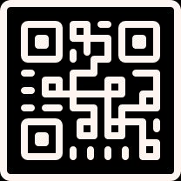

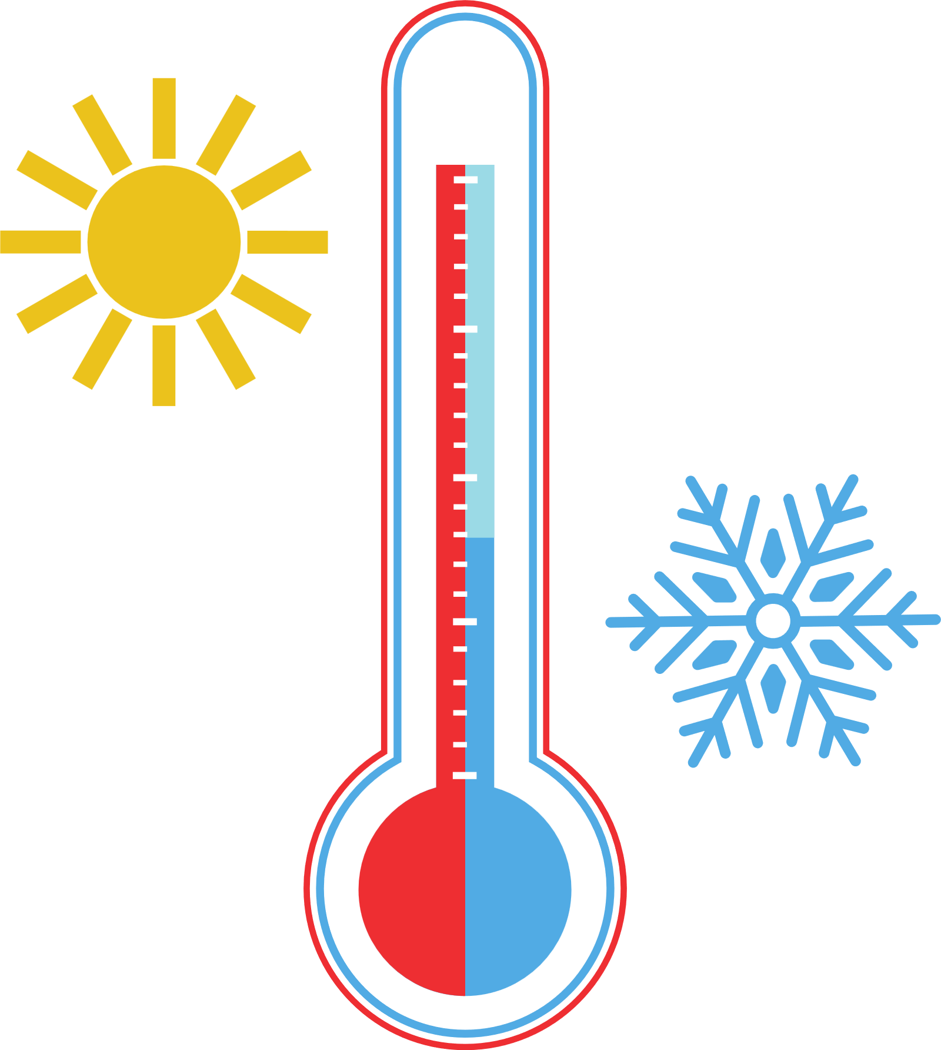

OBJECTIVES
1. QR Code Generator:
- Input field for URL/Text.
- Button to generate QR code.
- Display generated QR code image.
________________________________________________________________________________
2. Password Generator:
- Options for password length and character types (uppercase, lowercase, numbers, symbols).
- Button to generate password and display it.
________________________________________________________________________________
3. Temperature Converter:
- Input fields for Celsius and Fahrenheit.
- Buttons to convert in both directions (Celsius to Fahrenheit and vice versa).
________________________________________________________________________________
4. To-Do List:
- Input field to add tasks.
- Options to edit, delete, and mark tasks as complete.
- Display list of current tasks.
- Visuals: Screenshots or icons representing each module's functionality.

Slide 6


ACTIVITIES INVOLVED
Development Phases:
REQUIREMENT ANALYSIS: GATHERED USER REQUIREMENTS AND DEFINED PROJECT SCOPE.
DEPLOYMENT AND
USER TRAINING
CREATED WIREFRAMES AND UI DESIGNS FOR THE APPLICATION.
Design and
Prototyping:
DEVELOPD THE APPLICATION USING PYTHON AND CUSTOMTKINTER.
Testing and
Debugging
CONDUCTED THOROUGH TESTING TO IDENTIFY AND FIX ISSUES.
DEPLOYMENT AND
USER TRAINING:
RELEASED THE APPLICATION AND PROVIDE TRAINING MATERIALS.

Slide 7
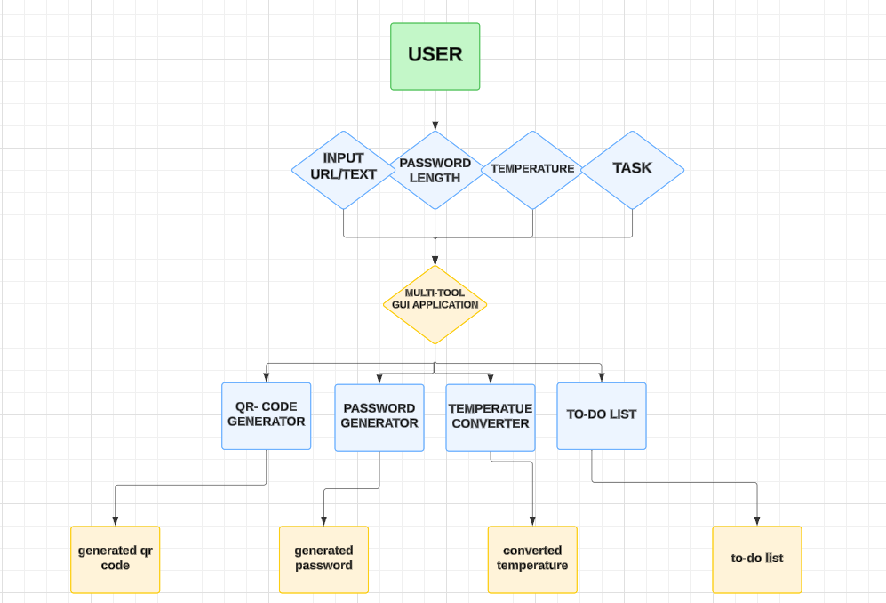

DATA FLOW DIAGRAM (DFD)

Slide 8

TECHNOLOGY USED
Programming Language: Python
Framework: CustomTkinter for creating modern GUIs
_________________________________________
Libraries:
qrcode: For generating QR codes.
PIL (Pillow): For image handling and displaying QR codes.
Visuals: Logos of Python, CustomTkinter, and relevant libraries.

Slide 9
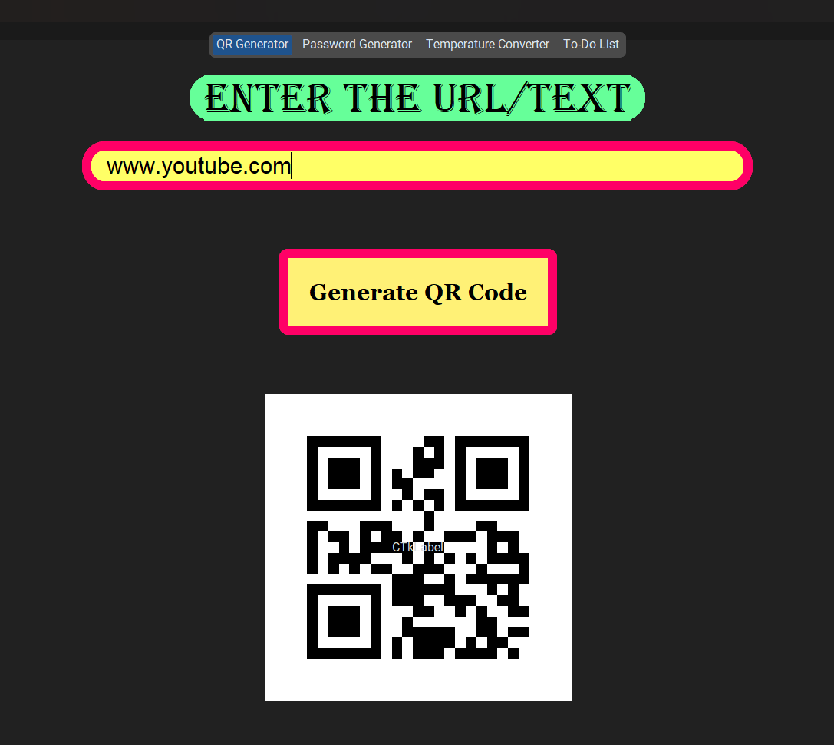
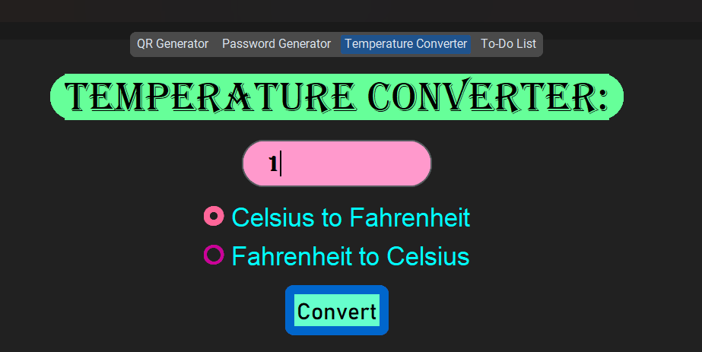
USER INTERFACE

Slide 10
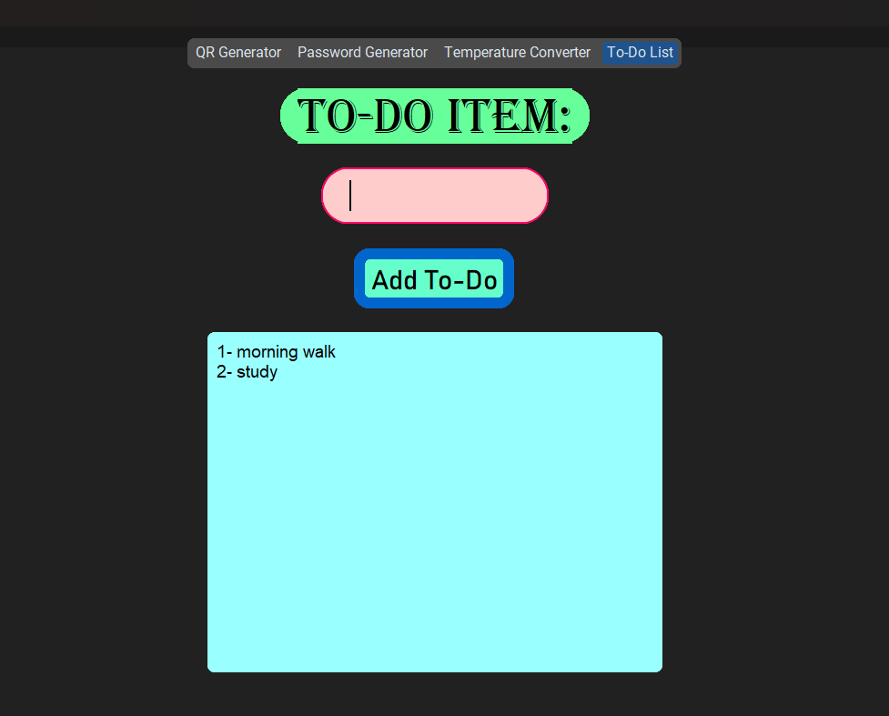
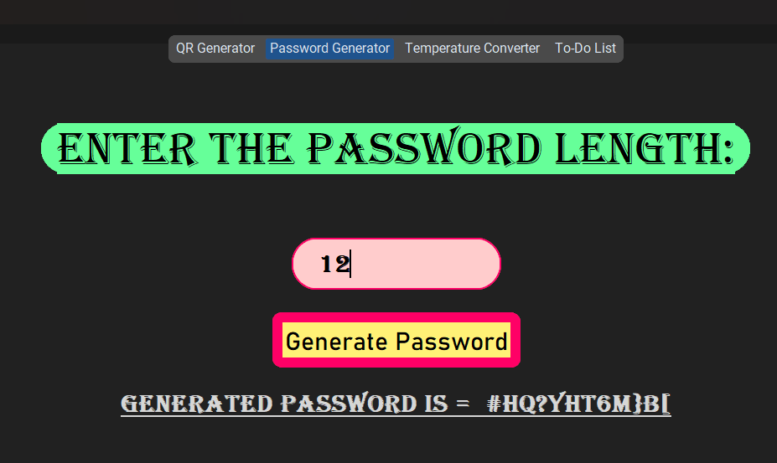
USER INTERFACE

Slide 11

CONCLUSION
Summary:
1. The Multi-Tool GUI Application provides a comprehensive solution for everyday tasks in a single interface.
2. Enhances user productivity by minimizing the need to switch between multiple applications.
____________________________________________________________
Future Work:
1. Potential enhancements could include cloud synchronization for task management, mobile application development, or additional utilities based on user feedback.
2. Visuals: A summary graphic or a bulleted list highlighting key takeaways.

Slide 12

THANK YOU!

